Slide 1
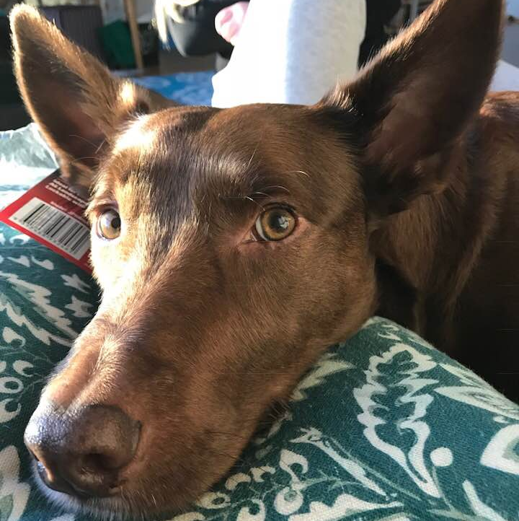
MARKING LIKE A BOSS
How to remember tricky word parts

Slide 2
UNDERLINE - IT’S FINE!

Slide 3
CROSS LIKE A BOSS!

Slide 4
SHOW THE BOSSY LETTERS!

Slide 5
SHOW THE ODDBALLS!

Slide 6
SYLLABLES HAVE MEANING!

Slide 7
NOW IT’S YOUR TURN!

Slide 8
UNDERLINE - IT’S FINE!
think
draw
fight
shop
think
draw
fight
shop

Slide 9
CROSS LIKE A BOSS!
rage
climb
autumn

Slide 10
SHOW THE BOSSY LETTERS!
made
want
gym

Slide 11
SHOW THE ODDBALLS!
to
many
does

Slide 12
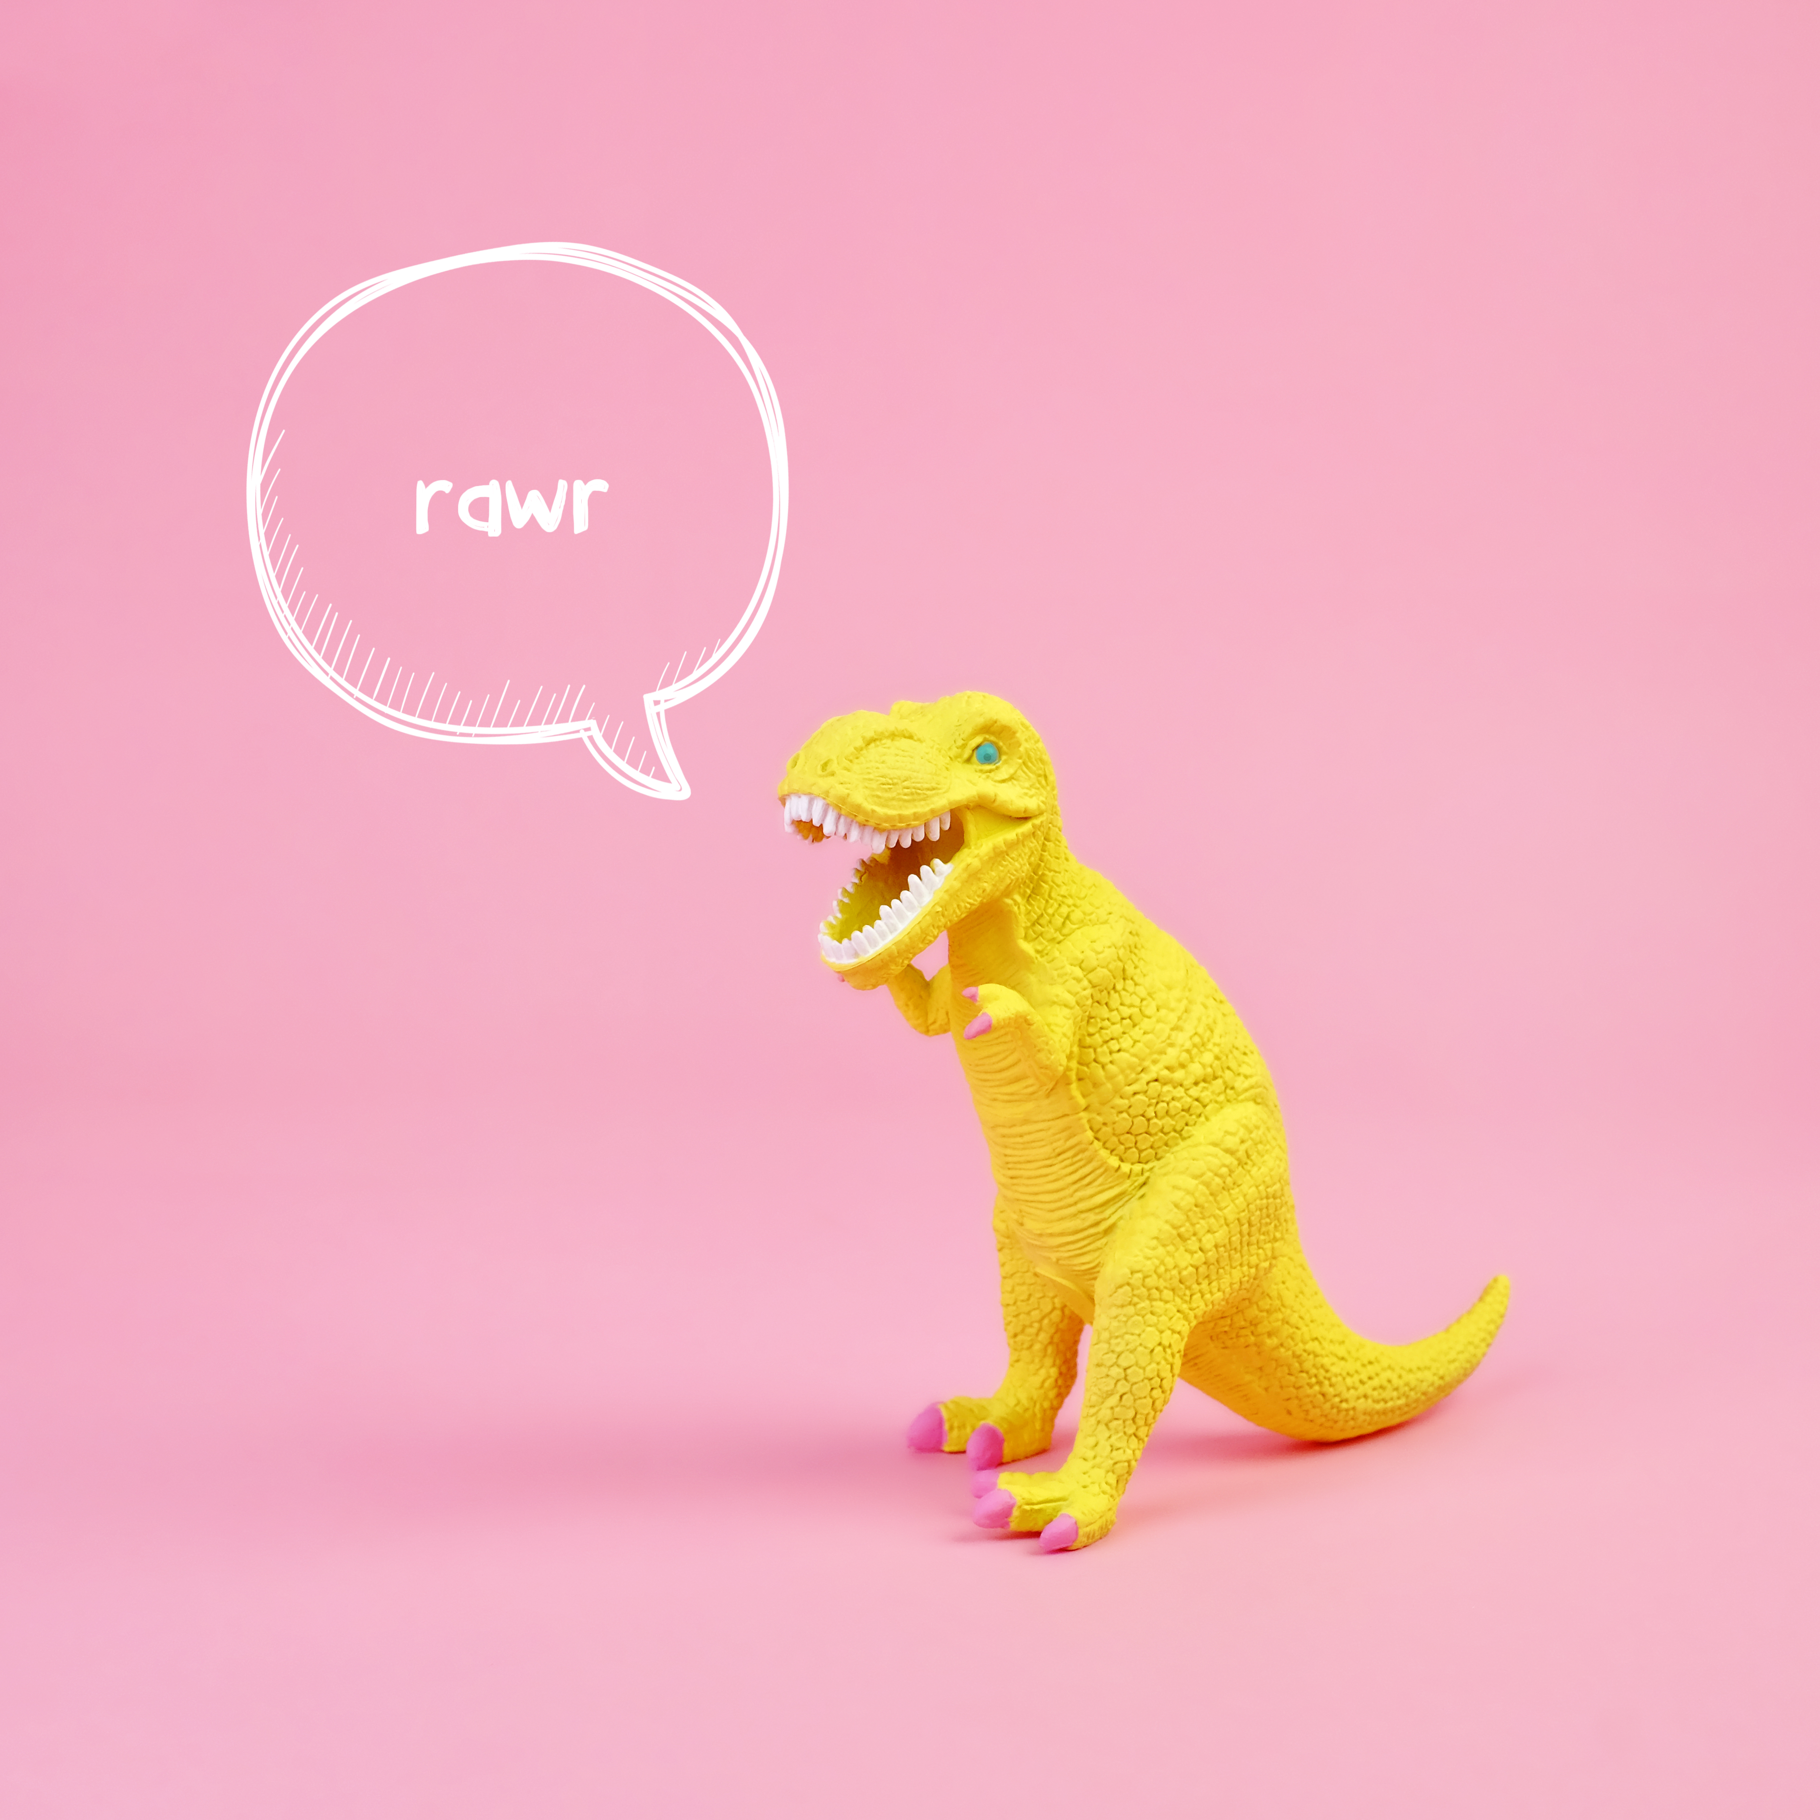
SYLLABLES HAVE MEANING!
replay
unhelpful
dinosaur
re play
un help ful
di no saur

